Slide 1
System Analyst in Consulting Firms
Kelompok 5 :
Albert
Agusdianto
Bayu
Linda
Patrick
Rinaldo
WilliamSS

Slide 2
Perusahaan Consulting
Merupakan expert untuk pihak lainnya.
Digunakan pada saat perusahaan lain membutuhkan pendapat
Memberikan best-practices untuk perusahaan

Slide 3
Perusahaan Consulting
Organizational Change Management
Technology Implementation
Business Process Reengineering
Business Strategy Development
Operational Improvement

Slide 4
Keuntungan bekerja di Perusahaan Consulting
Benchmark untuk menjadi Leader di Bisnis
Relasi dengan Perusahaan
Valuable Training
Client Skill
Higher Compensation
Flexibility in schedule

Slide 5
Alasan untuk tidak bekerja di Perusahaan Consulting
An Entrepreneurial bug
Lack of Consumer Focus
Consulting is a service not product

Slide 6
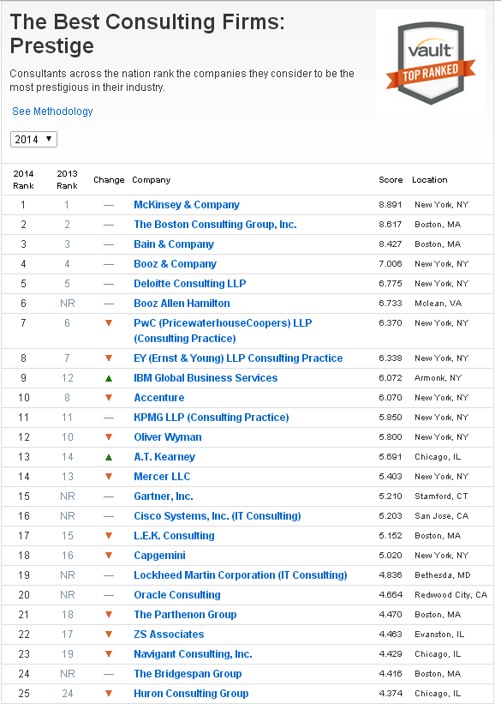
Perusahaan Consulting terbaik

Slide 7
System Analyst
Desainer untuk solusi IT baru bagi Perusahaan untuk meningkatkan efisiensi dan efektivitas bisnis.
Klien Internal dan Klien External
Bekerja sama dengan Klien untuk implementasi solusi yang baru
Menganalisa dari segi bisnis dan juga teknologi

Slide 8
System Analyst Work Activities
Penghubung antar pihak internal dan external
Menganalisa system klien yang sudah ada
Memahami requirement dari klien
Mengidentifikasi alternatif solusi yang ada
Menghasilkan laporan
Mengajukan proposal untuk klien
Mengawasi implementasi system baru
Membuat user manual
Memberi pelatihan

Slide 9
Cara menjadi System Analyst
Tidak memerlukan sertifikasi
Lulus dari bidang teknologi
Memahami bisnis
Mampu menganalisa sistem

Slide 10
System Analyst di perlukan
Mengerti dari sisi client mengenai proses bisnis,alur perusahaan,simpan data dan yang terkait
Memimpin system baru yang akan diinstall.agar sesuai dengan keinginan user.
Menganalisa dan mendesain functional bisnis perusahaan

Slide 11
Peran System Analyst
Memastikan klien sesuai dengan expektasi dan kebutuhan
Perform system testing
Membantu perusahaan mengerti tantangan yang dihadapi
Mendesain solusi
Memberikan tugas kepada programmer dalam pengembangan system

Slide 12
Tanggung jawab System Analyst
Memastikan requirement sesuai dengan bisnis perusahaan
Mendokumentasikan secara tepat sebelum solusi di kembangkan dan di implementasi
Identifikasi kebutuhan sumber daya yang dibutuhkan

Slide 13
Perbedaan antara System Analyst dan Business Analyst
Business Analyst merupakan System Analyst juga
Business Analyst menjembatani lebih lanjut masalah bisnis lebih lanjut dan masalah functional diserahkan ke System Analyst

Slide 14
System Development Life Cycle
Planning
System Analysis
System Design
Development
Testing
Implementation
Maintenance
Evaluation
Notes:
Preliminary analysis: The objective of phase 1 is to conduct a preliminary analysis, propose alternative solutions, describe costs and benefits and submit a preliminary plan with recommendations.
Conduct the preliminary analysis: in this step, you need to find out the organization's objectives and the nature and scope of the problem under study. Even if a problem refers only to a small segment of the organization itself then you need to find out what the objectives of the organization itself are. Then you need to see how the problem being studied fits in with them.Propose alternative solutions: In digging into the organization's objectives and specific problems, you may have already covered some solutions. Alternate proposals may come from interviewing employees, clients, suppliers, and/or consultants. You can also study what competitors are doing. With this data, you will have three choices: leave the system as is, improve it, or develop a new system.Describe the costs and benefits.Systems analysis, requirements definition: Defines project goals into defined functions and operation of the intended application. Analyzes end-user information needs.
Systems design: Describes desired features and operations in detail, including screen layouts, business rules, process diagrams, pseudocode and other documentation.
Development: The real code is written here.
Integration and testing: Brings all the pieces together into a special testing environment, then checks for errors, bugs and interoperability.
Acceptance, installation, deployment: The final stage of initial development, where the software is put into production and runs actual business.
Maintenance: During the maintenance stage of the SDLC, the system is assessed to ensure it does not become obsolete. This is also where changes are made to initial software. It involves continuous evaluation of the system in terms of its performance.
Evaluation: Some companies do not view this as an official stage of the SDLC, but is it an important part of the life cycle. Evaluation step is an extension of the Maintenance stage, and may be referred to in some circles as Post-implementation Review. This is where the system that was developed, as well as the entire process, is evaluated. Some of the questions that need to be answered include: does the newly implemented system meet the initial business requirements and objectives? Is the system reliable and fault-tolerant? Does the system function according to the approved functional requirements. In addition to evaluating the software that was released, it is important to assess the effectiveness of the development process. If there are any aspects of the entire process, or certain stages,that management is not satisfied with, this is the time to improve. Evaluation and assessment is a difficult issue. However, the company must reflect on the process and address weaknesses.
Disposal: In this phase, plans are developed for discarding system information, hardware and software in making the transition to a new system. The purpose here is to properly move, archive, discard or destroy information, hardware and software that is being replaced, in a matter that prevents any possibility of unauthorized disclosure of sensitive data. The disposal activities ensure proper migration to a new system. Particular emphasis is given to proper preservation and archival of data processed by the previous system. All of this should be done in accordance with the organization's security requirements

Slide 15
Preparing A Career as A System Analyst
Problem-Solving Skill
System analyst harus memiliki kemampuan untuk mengatasi masalah bisnis yang besar, memecahkan masalahnya menjadi bagian-bagian komponen, menganalisa berbagai aspek permasalahannya, dan menyusun sebuah system untuk mengatasi masalah
System analyst harus belajar untuk menganalisa masalah dari akar masalah dan dampaknya
System analis harus dapat secara kreatif mendefinisikan alternatif solusi mengenai masalah dan kebutuhannya

Slide 16
Preparing A Career as A System Analyst (Cont’d)
Information Technology Knowledge
System analyst bertanggung jawab untuk menunjukkan kepada end-user dan management tentang bagaimana teknologi baru dapat memberikat keuntungan terhadap bisnis dan operasinya
System analyst harus menyardari keberadaan teknologi informasi yang ada

Slide 17
Preparing A Career as A System Analyst (Cont’d)
Computer Programming Knowledge
System analyst harus mengetahui setidaknya logika mengenai cara pemikiran pemrogramman
Suatu asumsi / pemikiran yang salah bahwa programmer yang baik akan menjadi analyst yang baik, atau programmer yang buruk tidak daoat menjadi analyst yang baik

Slide 18
Preparing A Career as A System Analyst (Cont’d)
General Business Knowledge
System analyst perlu mengetahui operasi bisnis secara umum pada berbagai industri untuk memperkaya pengetahuan sebelum menganalisa atau memecahkan masalah

Slide 19
Preparing A Career as A System Analyst (Cont’d)
Interpersonal Communications and Relations Skill
System analyst harus dapat berkomunikasi secara efektif, baik tertulis maupun lisan
Kemampuan komunikasi adalah faktor terbesar dalam kesuksesan atau kegagalan karir ketimbang pada kemampuan teknikal
Kemampuan interpersonal dmembantu system analyst bekerja secara efektif dengan orang lain

Slide 20
Preparing A Career as A System Analyst (Cont’d)
Flexibility and Adaptability
System analyst akan ditempatkan di berbagai project dari industri yang luas
System analyst akan menghadapi berbagai macam karakter orang / tim dalam project
System analyst akan bekerja lembur jika diperlukan karena adanya tenggat waktu

Slide 21
Preparing A Career as A System Analyst (Cont’d)
Character and Ethic
Sifat dari pekerjaan System analyst membutuhkan karakter dan kesadaran etik yang kuat
system analyst harus sanagat berhati-hati untuk tidak menyebarkan informasi organisasi yang sensifit dan rahasia kepada orang lain baik itu didalam maupun di luar organisasi
System analyst harus tidak mengambil / menjual design dan prigram yang telah dikembangkannya ke perusahaan lain
System analyst memiliki kewajiban untuk memberikan contoh yang baik untuk end-user dan management, terutama di area hak cipta software
System analyst harus memiliki kontrol diri yang baik karena sebagian besar system analyst di perusahaan consulting bekerja di bawah tekanan

Slide 22
Daftar Pustaka
http://careers.accenture.com/microsites/ireland-graduate-joiners/what-does-acn-do/Pages/what-is-consulting.aspx
http://www.businessdictionary.com/definition/consulting.html
http://www.wallstreetservices.com/blog/4-benefits-of-working-as-a-consultant
http://managementconsulted.com/consulting-jobs/why-i-left-mckinsey-part-2/
http://managementconsulted.com/consulting-jobs/why-i-left-mckinsey-part-1/#
http://www.prospects.ac.uk/systems_analyst_job_description.htm
http://www.wgu.edu/blogpost/how-become-computer-systems-analyst
http://www.slideshare.net/infinityrulz/roles-responsibilities-of-system-analyst-3043450
http://www.bridging-the-gap.com/difference-between-a-business-analyst-and-systems-analyst/
http://www.prenhall.com/behindthebook/0132240858/pdf/Kendall_Feature1_Why_We_Wrote_This_Book.pdf
binus.ac.id

